Slide 1
Outreach Committee
Marketing Concept
20.03.2024

Slide 2



CAMARA Outreach Committee Marketing Goals
Internal
External: Advertise API ecosystem and CAMARA, to:
win developers (of “end customers”) for work in CAMARA (bring in demand) and API usage
win developers of aggregators and marketplaces (to integrate and expose CAMARA APIs)
ISVs (software companies including APIs in their SDK, products, ...)
operators (to work in CAMARA and implement APIs)
network equipment vendors (to align their product roadmaps)
win additional sponsors
Internal: Advertise API ecosystem and CAMARA, to:
strengthen the CAMARA community
Partner with GSMA, other Open Source Projects and foundations, etc. to leverage synergies

Slide 3
CAMARA Outreach Committee Marketing Goals
Advertise API ecosystem and CAMARA to:
Drive API usage
Increase API availability in operators and across channels
Grow CAMARA membership
Strengthen the CAMARA community
Audience
Software application developers
Mobile network operators
CAMARA community
1
2
3
Partner with GSMA, other Open Source Projects and foundations, and other similar organizations to cross-promote

Slide 4
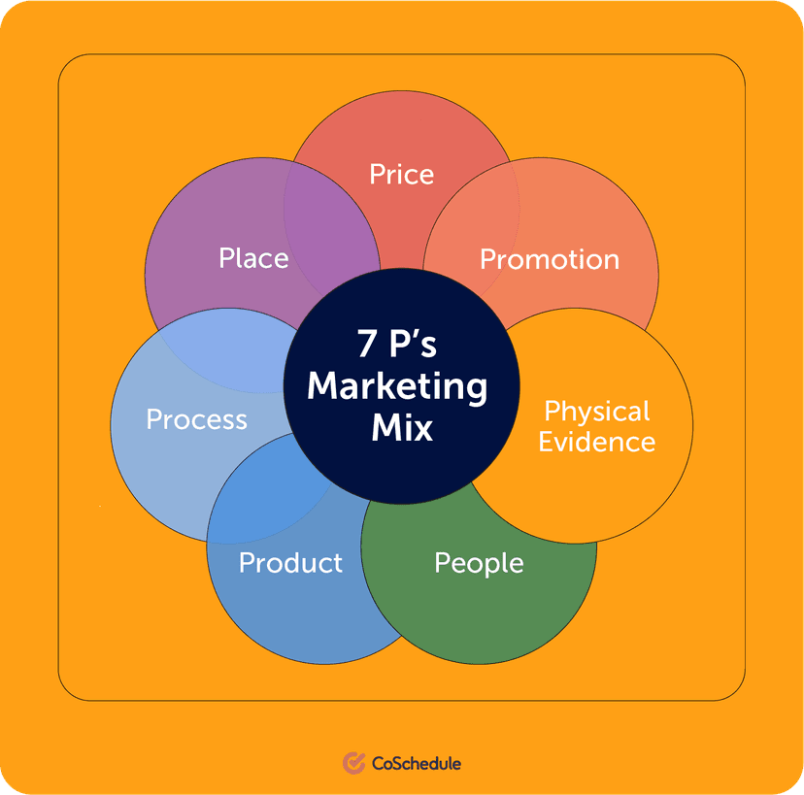
CAMARA Outreach Committee Marketing Theory
Internal
Marketing is the art and process of developing, executing, and maintaining an exchange relationship. It begins with attracting the customers, building a relationship with them, and finally keeping it by satisfying their needs.
The idea behind the marketing concept is to predict and satisfy the needs and wants of customers better than the competitors. By that develop customers from awareness, interest, desire to action.
Marketing principles:
Product
Price
Place
Promotion
People
Process
Packaging/Physical Evidence

Slide 5
CAMARA Outreach Committee Marketing Plan
Internal
Customers: Developers of end customers “B2B” and aggregators/marketplaces “Wholesale”.
Needs and wants: Easy to consume, globally standardized/available, telco APIs which fulfill the functional demand to improve applications or enable new ones.
Principles:
Product: Join CAMARA to develop APIs (and ensure own demand is considered) and get all assets to use it.
Price: Free.
Place: Developer events.
Promotion: Keynote presentation, testing experience with real APIs.
People: LF or CAMARA management representative, developer evangelists from operators in the market.
Process: CAMARA contact page → join technical project by all+subscribe@lists.camaraproject.org.
Packaging/Physical Evidence: n/a.

Slide 6
CAMARA Outreach Committee Marketing Plan
Win developers
Audience: Software application developers
Needs and wants: Easy to consume, globally standardized/available telco APIs that enable improved or new applications
Activities: Conferences and Events
CAMARA presence at conferences and events that target developers
Keynote presentation, testing experience with real APIs
Messaging
Join CAMARA to develop APIs and influence roadmap

Slide 7
CAMARA Outreach Committee Marketing Plan
Internal
Customers: Strategy departments and product owners of operators.
Needs and wants: Enable new revenue chains in API business / digital telco. Be part of innovation and conversation.
Principles:
Product: Join CAMARA to develop APIs (and ensure own demand is considered) and get all assets to use it.
Price: Free.
Place: Telco events.
Promotion: Keynote presentation.
People: LF or CAMARA management representative.
Process: CAMARA contact page → join technical project by all+subscribe@lists.camaraproject.org, join CAMARA Fund by https://enrollment.lfx.linuxfoundation.org/?project=camarafund.
Packaging/Physical Evidence: n/a

Slide 8
CAMARA Outreach Committee Marketing Plan
Win operators
Audience: Strategy departments and product owners of operators
Needs and wants: Enable new revenue chains in API business / digital telco. Be part of innovation and conversation.
Activities: Conferences and Events
CAMARA presence at telco conferences and events
Keynote presentation
Messaging
Join CAMARA to develop APIs and influence roadmap

Slide 9
CAMARA Outreach Committee Marketing Plan
Internal
Customers: CAMARA community.
Needs and wants: Recognition for community work.
Principles:
Product: Achievements.
Price: Free.
Place: All Hands Calls, E-Mails to “all” distribution list, Website announcements.
Promotion: Presentation.
People: LF or CAMARA management representative.
Process: n/a.
Packaging/Physical Evidence: n/a

Slide 10
CAMARA Outreach Committee Marketing Plan
Strengthen community
Audience: CAMARA community
Needs and wants: Recognition for community work
Activities: Conferences and Events
All Hands Calls
E-Mails to “all” distribution list
Website announcements
Messaging
Achievements

Slide 11
Thank you!

